Slide 1

Cloud Computing and Virtualization
Presented by:
Saurabh Singhal
Assistant Professor

Slide 2
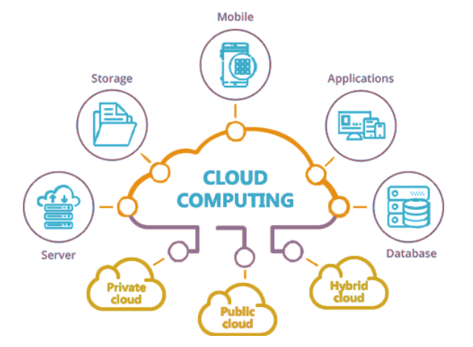
CLOUD COMPUTING Lecture 1

Slide 3
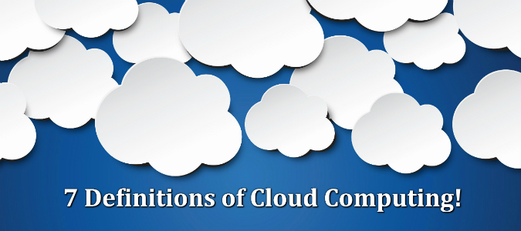
Define Cloud Computing
Cloud computing is the on-demand delivery of compute power, database storage, applications, and other IT resources through a cloud services platform via the internet with pay-as-you-go pricing.

Slide 4
What is Cloud Computing
Cloud Computing is a general term used to describe a new class of network based computing that takes place over the Internet,
basically a step on from Utility Computing
a collection/group of integrated and networked hardware, software and Internet infrastructure (called a platform).
Using the Internet for communication and transport provides hardware, software and networking services to clients

Slide 5
What is Cloud Computing
The term cloud has historically been used in the telecommunications industry as an abstraction of the network in system diagrams.
Cloud computing refers to both the applications delivered as services over the Internet and the hardware and system software in the datacenters that provide those services. [as per Armbrust et al]
Cloud computing is a model for enabling ubiquitous, convenient, on-demand network access to a shared pool of configurable computing resources (e.g., networks, servers, storage, applications, and services) that can be rapidly provisioned and released with minimal management effort or service provider interaction. [As per NIST]

Slide 6
What is Cloud Computing
As per Buyya et al: – A cloud is a type of parallel and distributed system consisting of a collection of interconnected and virtualized computers that are dynamically provisioned and presented as one or more unified computing resources based on service-level agreements established through negotiation between the service provider and consumers.

Slide 7

What is Cloud Computing
These platforms hide the complexity and details of the underlying infrastructure from users and applications by providing very simple graphical interface or API (Applications Programming Interface).

Slide 8
What is Cloud Computing
In addition, the platform provides on demand services, that are always on, anywhere, anytime and any place.
Pay for use and as needed,
Elastic scale up and down in capacity and functionalities

Slide 9
What is Cloud Computing
Cloud computing is an umbrella term used to refer to Internet based development and services.

Slide 10
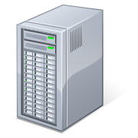
What is Cloud Computing
Shared pool of configurable computing resources
On-demand network access
Provisioned by the Service Provider
Applications
Services
Computer Network
Storage (Database)
SERvers
Notes:
Cloud computing is a model for enabling convenient, on-demand network access to a shared pool of configurable computing resources (e.g., networks, servers, storage, applications, and services) that can be rapidly provisioned and released with minimal management effort or service provider interaction.
cloud computing customers do not own the physical infrastructure.
Cloud computing users avoid capital expenditure (CapEx) on hardware, software, and services when they pay a provider only for what they use.
Low shared infrastructure and costs, low management overhead, and immediate access to a broad range of applications

Slide 11
Cloud Summary
A number of characteristics define cloud data, applications services and infrastructure:
Remotely hosted: Services or data are hosted on remote infrastructure.
Ubiquitous: Services or data are available from anywhere.
Commodified: The result is a utility computing model similar to traditional that of traditional utilities, like gas and electricity - you pay for what you would want!

Slide 12
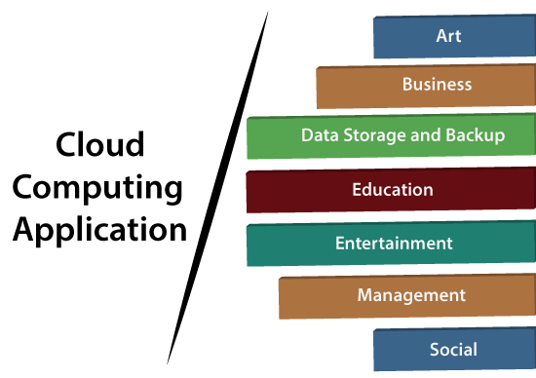

Slide 13
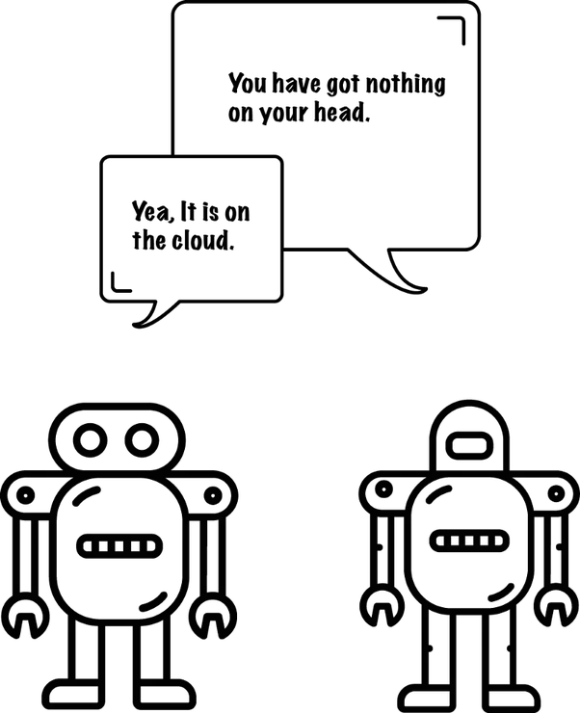
Traditional Vs Cloud computing

Slide 14
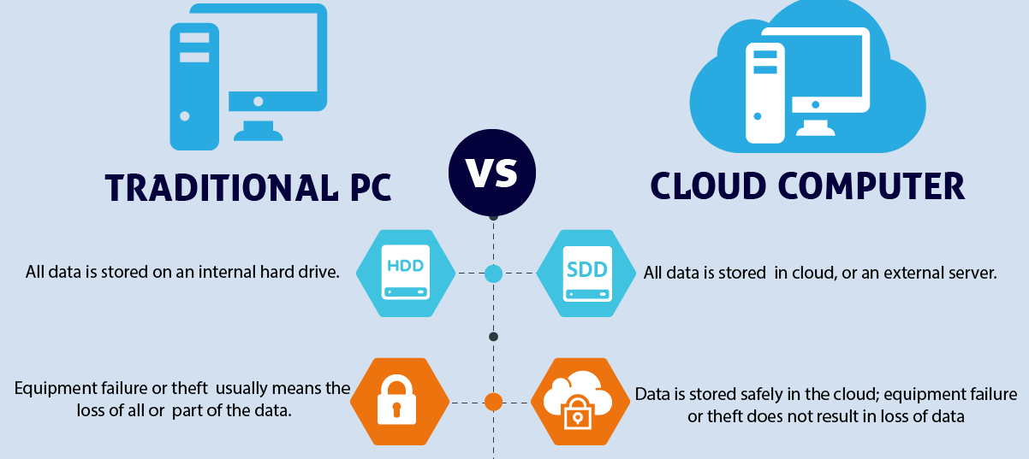
Traditional Vs Cloud computing

Slide 15
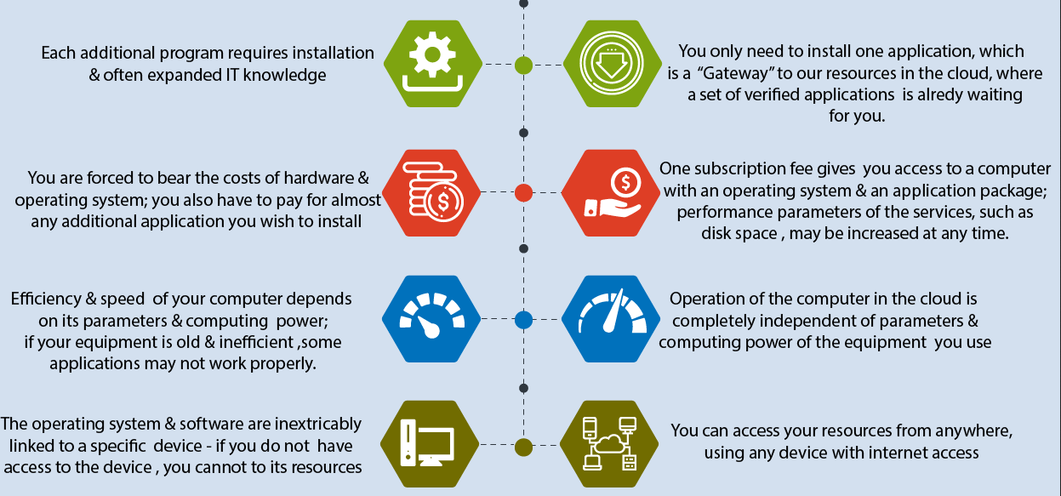
Traditional Vs Cloud computing

Slide 16
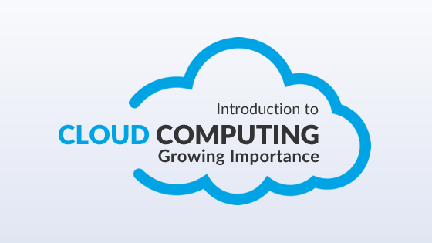
Importance of Cloud Computing

Slide 17
Cloud is inexpensive
Cloud computing helps in reducing a considerable amount of CAPEX (Capital Expenditure) & OPEX (Operational Expenditures) an organization does not need to invest in expensive hardware’s, storage devices, & software’s etc. and you only have to pay for the resources you utilize.

Slide 18
Elasticity & flexibility
Cloud computing enables you to reduce and increase your resources demands as per your requirements.
For e.g. if you have heavy traffic on your site you can increase your resources and vice versa.
Cloud computing gives you the flexibility to work from wherever you want and whenever you want all you require is an internet connection.

Slide 19
Auto Updating
Software updates and upgrades can be a painful thing cloud computing simplifies it for you as all the software maintenance and upgrades are looked after and regulated by your cloud service provider.

Slide 20
Increased collaboration
Cloud computing enables employees to work in a more collaborative and coordinated manner as all the data and information about the organization, & ongoing projects is available to every employee and can be accessed from anywhere and anytime which helps in reducing delays and increase productivity.

Slide 21
Agility & Speed
Time is the most crucial factor when it comes to decision-making and execution.
Cloud computing services have a very prompt and customer-centric SLA’s (Service Level Agreements).
Cloud Service providers offer up to 99.99% uptimes which ensure continuous flow of business operations and executions.

Slide 22
99.9999999% ("nine nines") means only 31.56 milliseconds downtime is allowed from a cloud service provider.

Slide 23
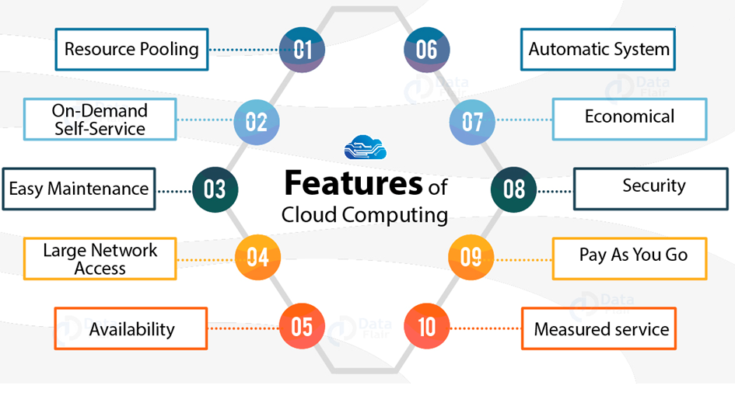
Features of Cloud Computing

Slide 24
Challenges
Security and Privacy
Lack of Standards
Continuously Evolving
Compliance Concerns
Legal issues

Slide 25
What is Cloud Service???
According to Reese – The service is accessible via a Web browser (nonproprietary) or a Web services application programming interface (API).
Zero capital expenditure is necessary to get started.
You pay only for what you use as you use it.

Slide 26
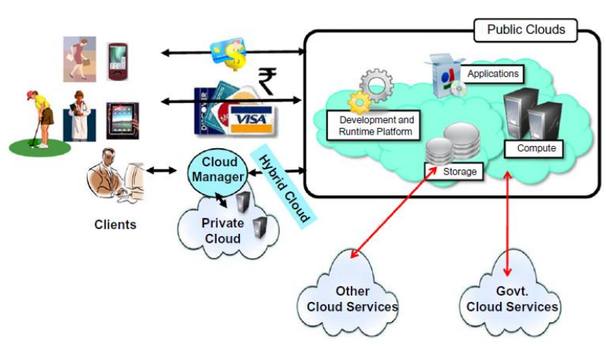
Overall view of Cloud Computing

Slide 27
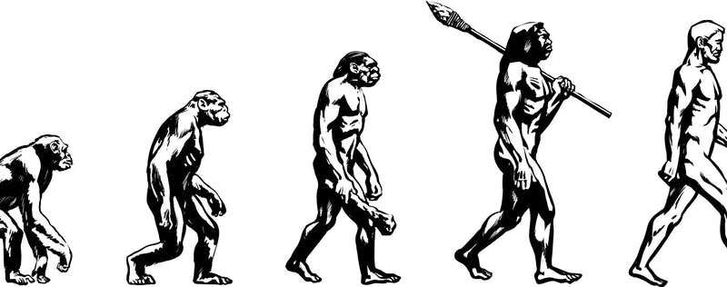
EVOLUTION OF CLOUD COMPUTING

Slide 28
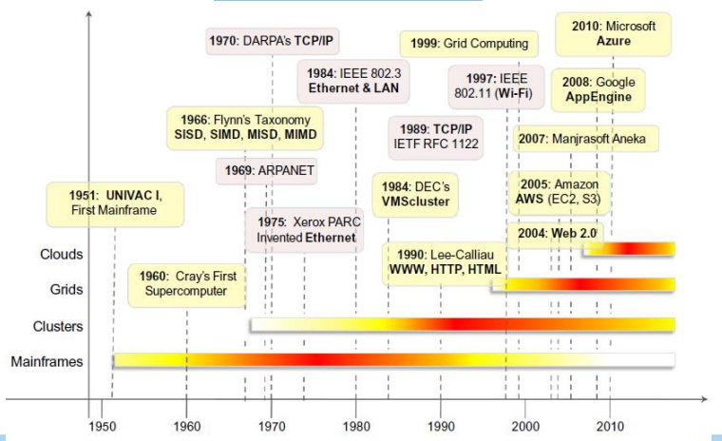
The evolution of computing technologies

Slide 29
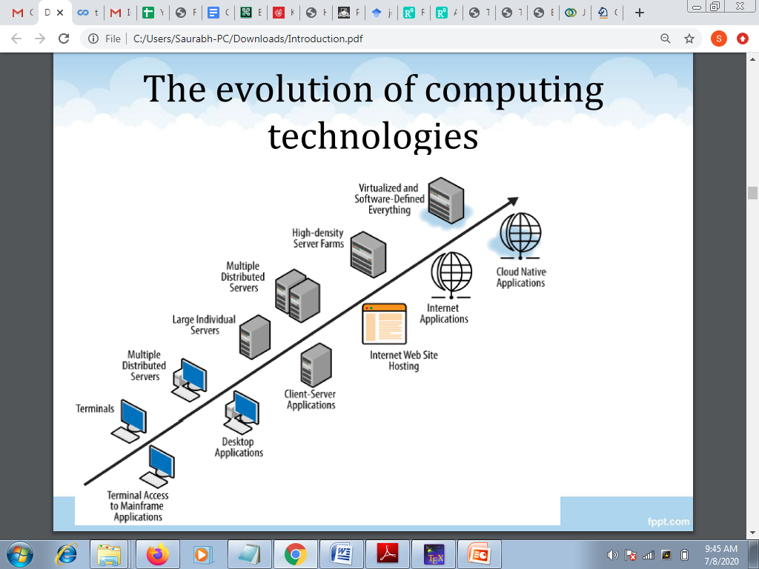
The evolution of computing technologies

Slide 30
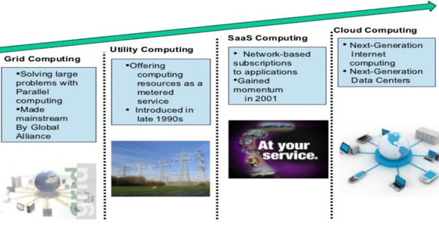
Evolution of Cloud Computing

Slide 31
The evolution of computing technologies- Mainframe Computing
These were the first examples of large computational facilities leveraging multiple processing units.
Mainframes were powerful, highly reliable computers specialized for large data movement and massive input/output (I/O) operations.
They were mostly used by large organizations for bulk data processing tasks such as online transactions, enterprise resource planning, and other operations.
Even though mainframes cannot be considered distributed systems, they offered large computational power by using multiple processors, which were presented as a single entity to users.

Slide 32
The evolution of computing technologies- Cluster Computing
Cluster computing started as a low-cost alternative to the use of mainframes and supercomputers.
The technology advancement that created faster and more powerful mainframes and supercomputers eventually generated an increased availability of cheap commodity machines as a side effect.
These machines could then be connected by a high bandwidth network and controlled by specific software tools that manage them as a single system.
Starting in the 1980s, clusters become the standard technology for parallel and high-performance computing

Slide 33
The evolution of computing technologies- Cluster Computing
They were cheaper than mainframes and made high performance computing available to a large number of groups .
Cluster technology contributed considerably to the evolution of tools and frameworks for distributed computing, including Condor, Parallel Virtual Machine (PVM), and Message Passing Interface (MPI).
One of the attractive features of clusters was that the computational power of commodity machines could be leveraged to solve problems that were previously manage able only on expensive super computers.
Moreover, clusters could be easily extended if more computational power was required.

Slide 34
The evolution of computing technologies- Grid Computing
Grid computing appeared in the early 1990s as an evolution of cluster computing.
Grid computing proposed a new approach to access large computational power, huge storage facilities, and a variety of services.
Grids initially developed as aggregations of geographically dispersed clusters by means of Internet connections.
These clusters belonged to different organizations, and arrangements were made among them to share the computational power.

Slide 35
The evolution of computing technologies- Grid Computing
Grid computing - combination of computer resources from multiple administrative domains applied to a common task
Grid computing is a computer network in which each computer's resources are shared with every other computer in the system.
Processing power, memory and data storage are all community resources that authorized users can tap into and leverage for specific tasks.

Slide 36
Utility Computing
Utility computing focus is on the business model on which providing the computing services are based. , as a metered service similar to a traditional public utility (such as electricity, water, natural gas, or telephone network).
Utility computing merely means "Pay and Use", with regards to computing power.

Slide 37
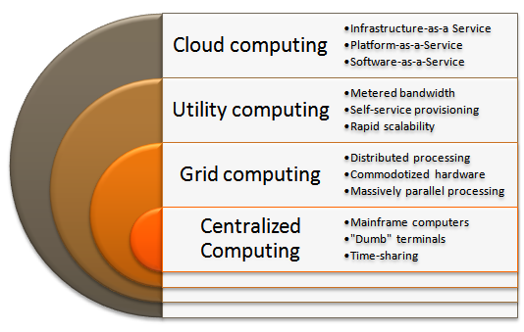
Quick Revision

Slide 38


